Slide 1
Droplet evaporation, 0D analysis
Pure solvent

Slide 2
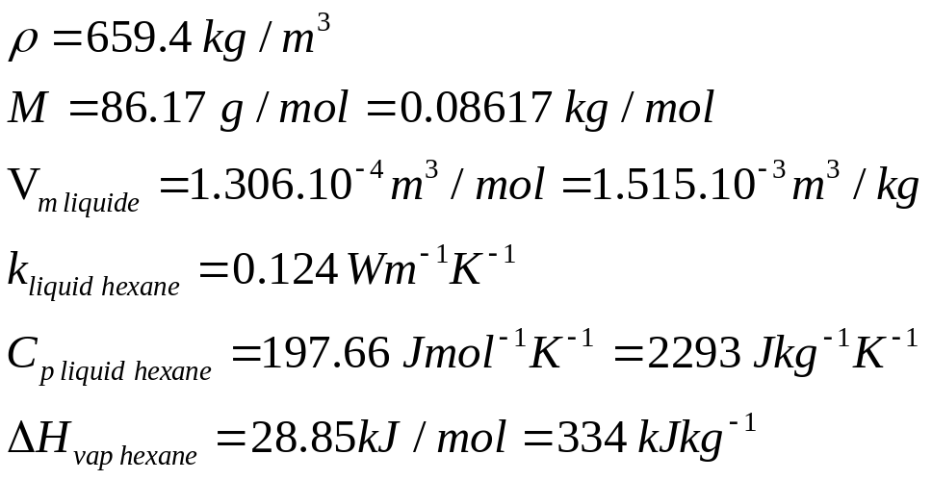
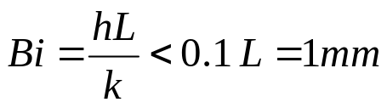
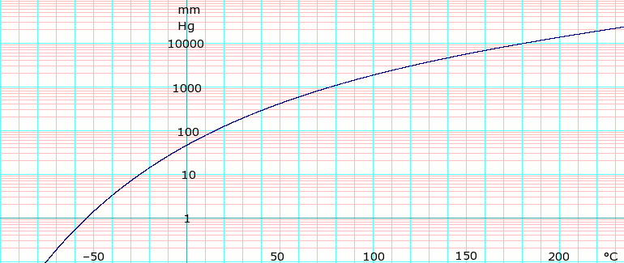

Data for hexane :

Slide 3
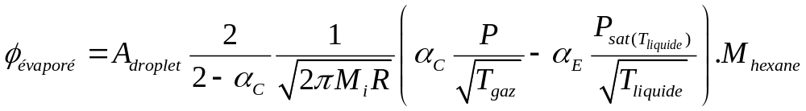
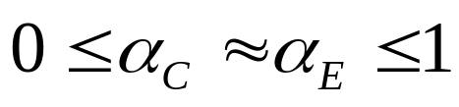
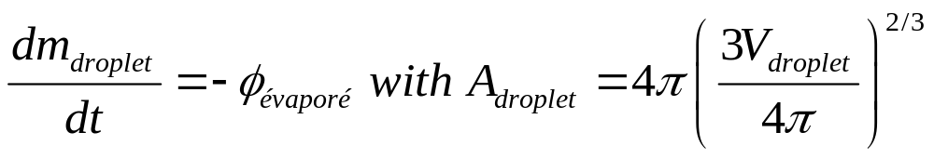
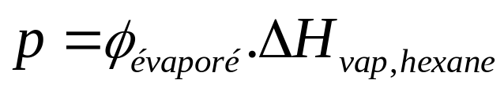
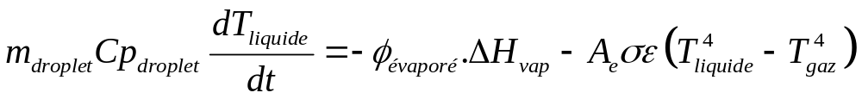
Mass transport and heat transfer
The evaporating flux is given by the Hertz-Knudsen Schrage relationship :
kg.s⁻¹
m²
kg.mol⁻¹
The differential equation to solve for mass balance is :
W
kg.s⁻¹
J.kg⁻¹
The differential equation to solve for heat balance is :

Slide 4
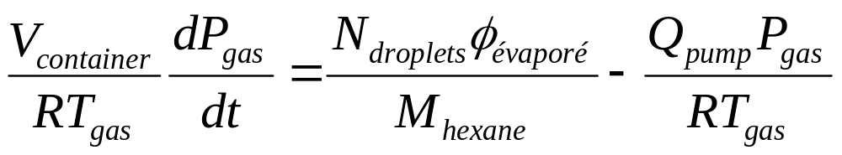
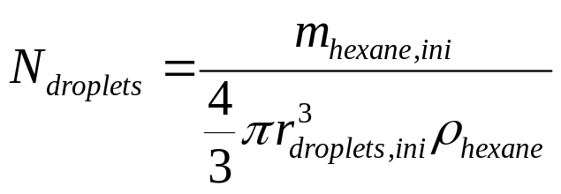
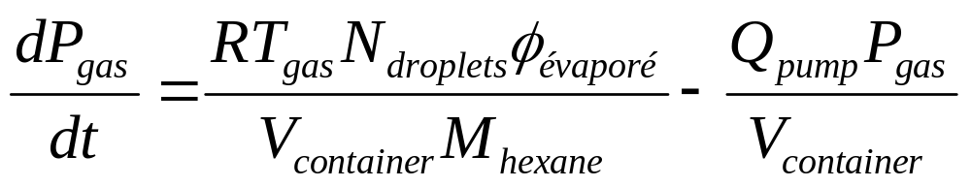
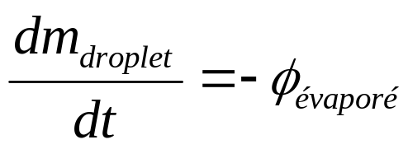
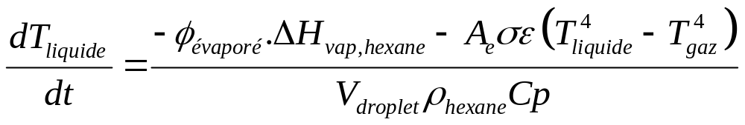
If the droplets are contained in a fixed volume where the gas temperature is fixed :
So you have to solve :

Slide 5

Initial release in vacuum at t=0, room temperature, near zero pressure into reactor
Flash vaporization and cooling (timescale ≈ ms)
1
Splats deposition
Pseudo-equilibrium state, cold or freezed, in equilibrium with reactor pressure
2
Vaporization of solvent (timescale ≈ s)
Remaining droplet of solvent and precursor
3
Vaporization of solvent (timescale ≈ s)
New pseudo-equilibrium state with pure precursor core
Powder deposition
4
Complete vaporization of precursor (timescale ≈ s)
Gaseous precursor
Conformal deposition

Slide 6
Flash vaporization step
Pseudo-equilibrium vaporization steps
Intense mass flux in molecular regime
Low heat flux coming from radiation
Heat flux coming from the droplet
Intense cooling
Low mass flux in molecular regime
During the flash vaporization, the kinetic is limited by a Hertz-Knudsen flux.
During the pseudo-equilibrium vaporization, the flux is limited by radiative thermal balance.

Slide 7
Tracking the droplets

Slide 8


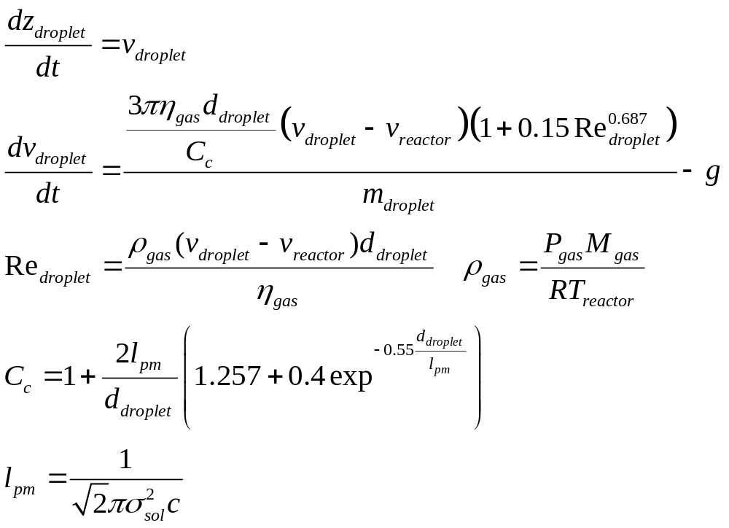


If the pumping rate is constant and the reactor plug-flow type, the vertical velocity of gas is constant (but not the pressure) :
The force balance on the droplet in Stokes regime is :

Slide 9
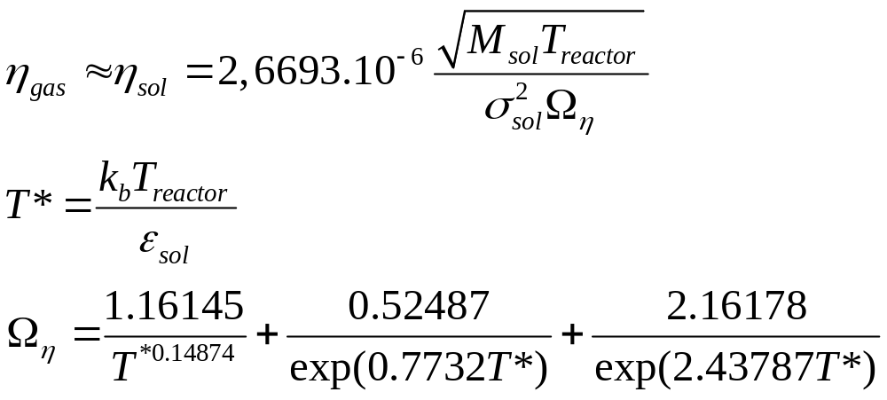
The gaz viscosity is approximated as the one of solvent at reactor temperature :

Slide 10

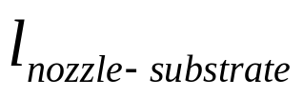

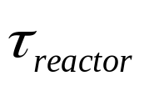


Slide 11
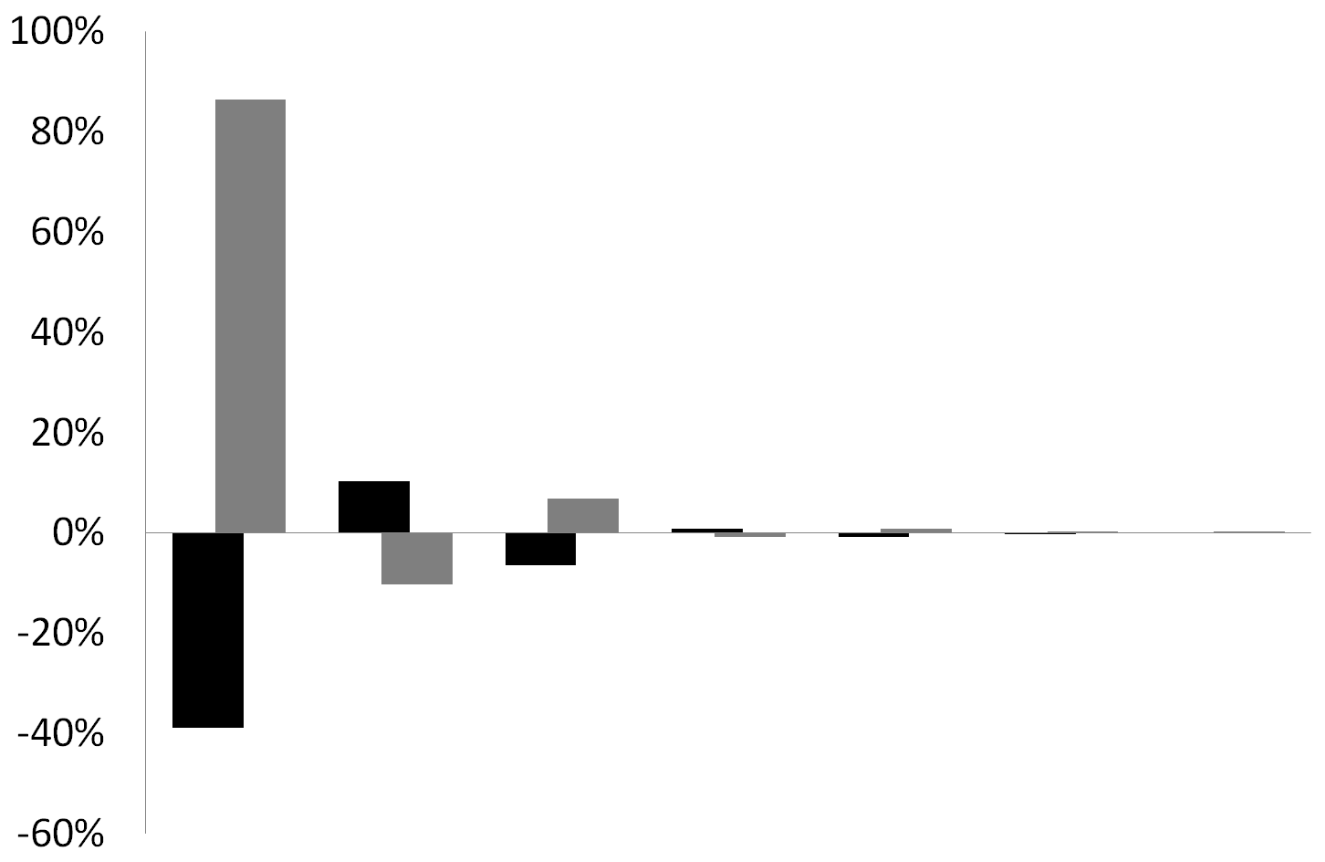
Droplet initial temperature
Initial mass
Evaporation coefficient
Reactor volume
Reactor wall temperature
Pumping rate
Droplet diameter
+10%
-10%

Slide 12
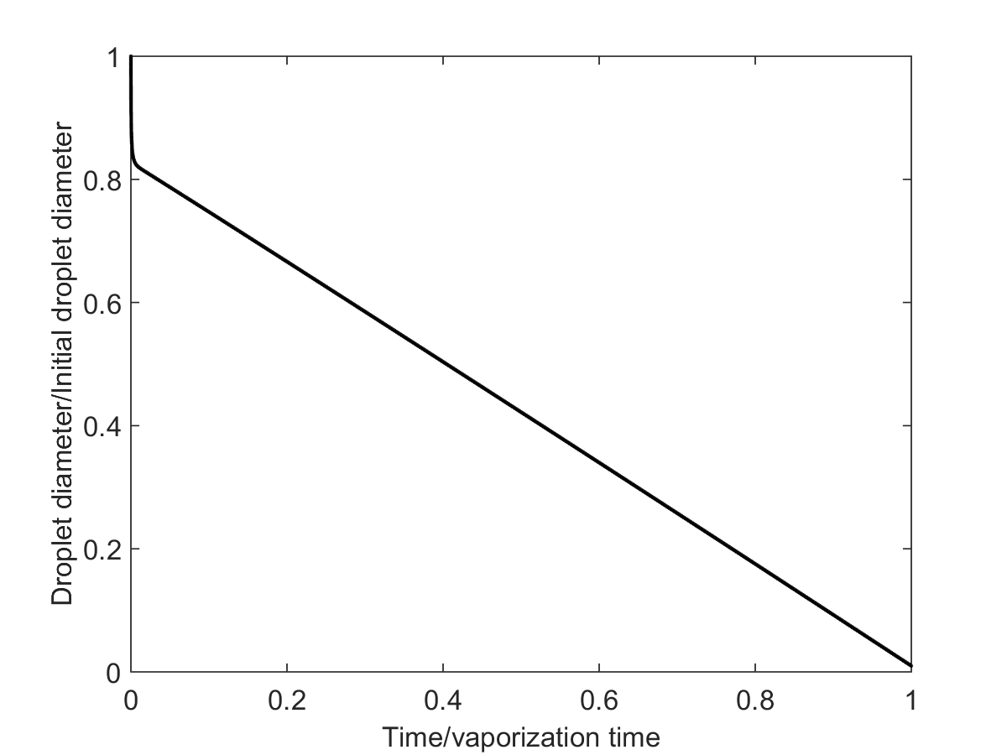
Flash vaporisation
Pseudo-equilibrium vaporization

Slide 13
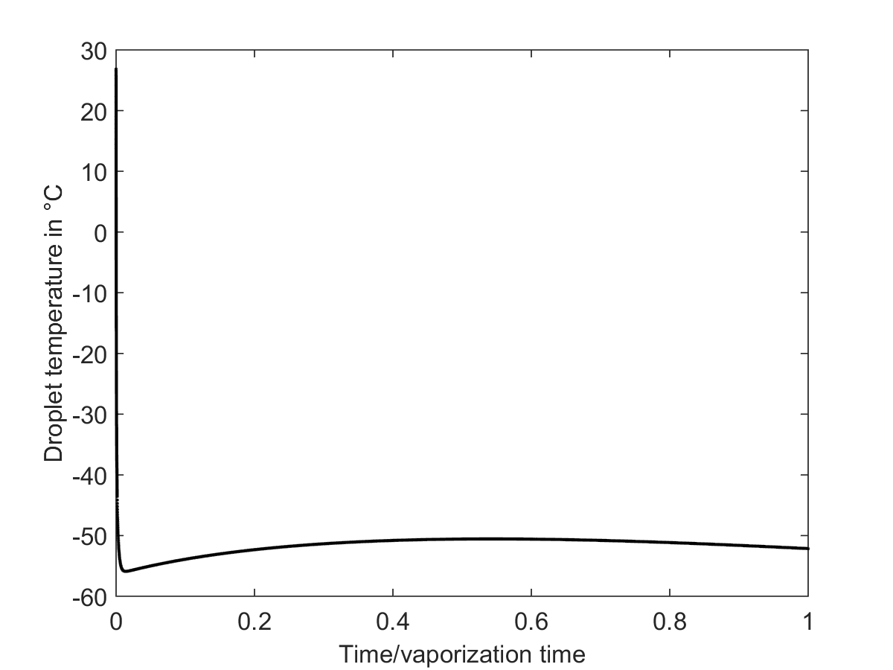
Flash vaporisation
Pseudo-equilibrium vaporization

Slide 14
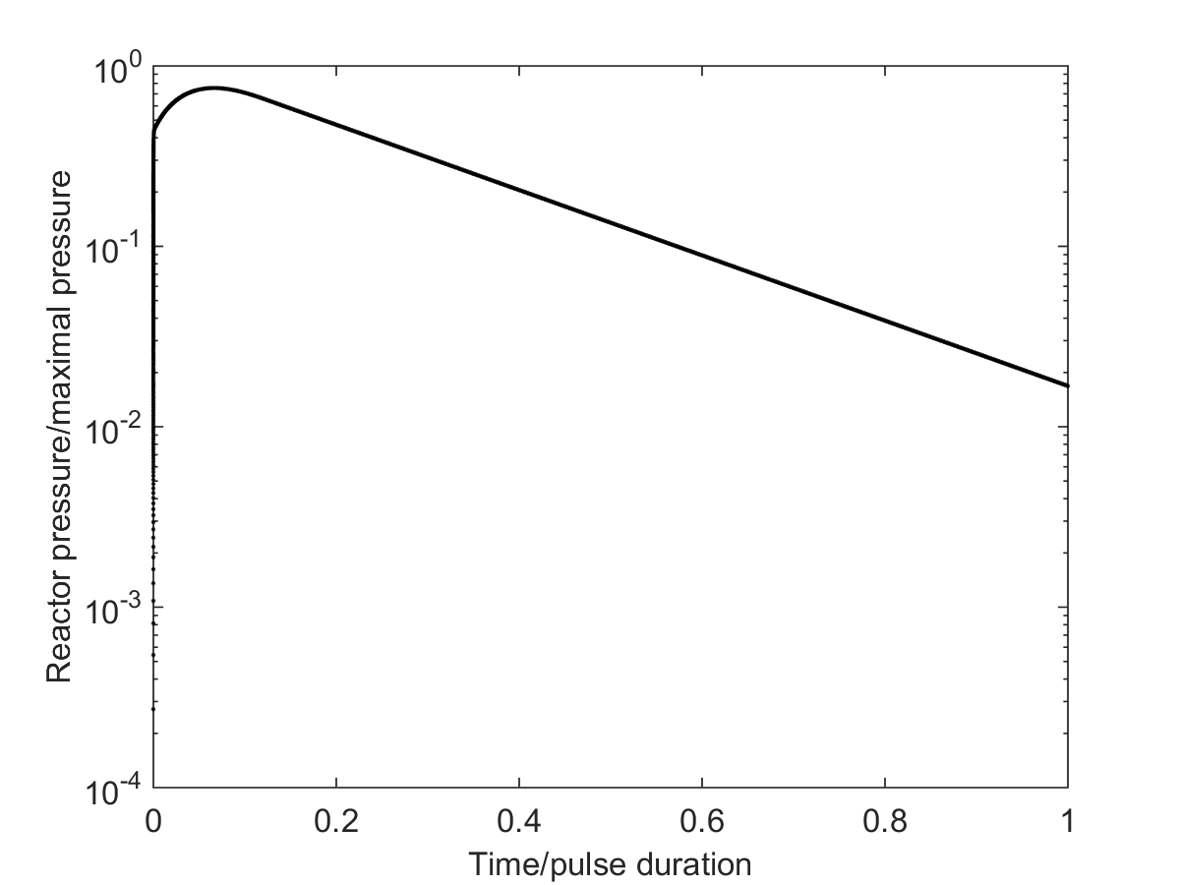
Pseudo-equilibrium vaporization
Flash vaporisation
Solvent pumping
End of solvent vaporization

Slide 15
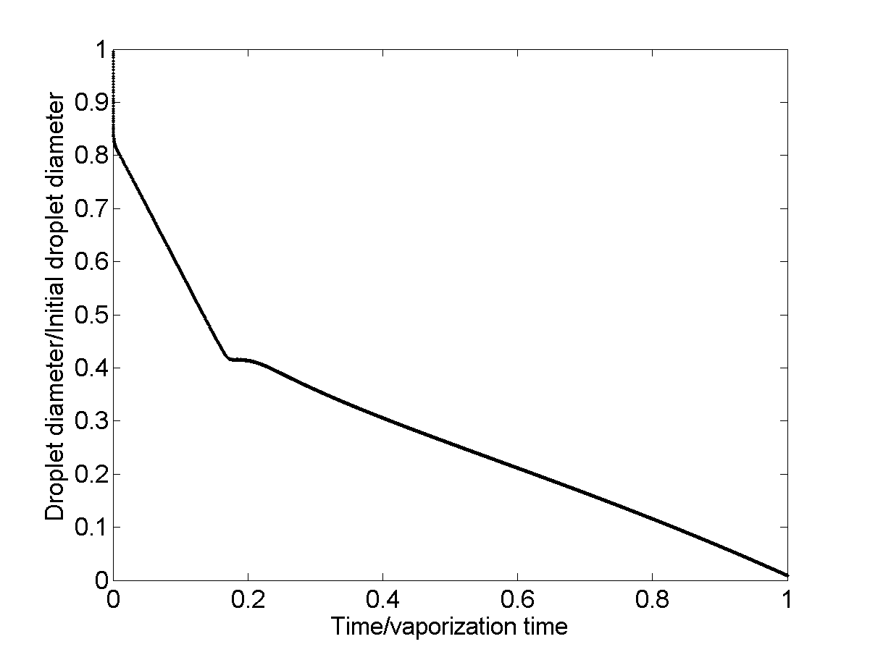
Flash vaporisation
End of solvent vaporization
Pseudo-equilibrium
Vaporization of solvent
Vaporization of precursor

Slide 16
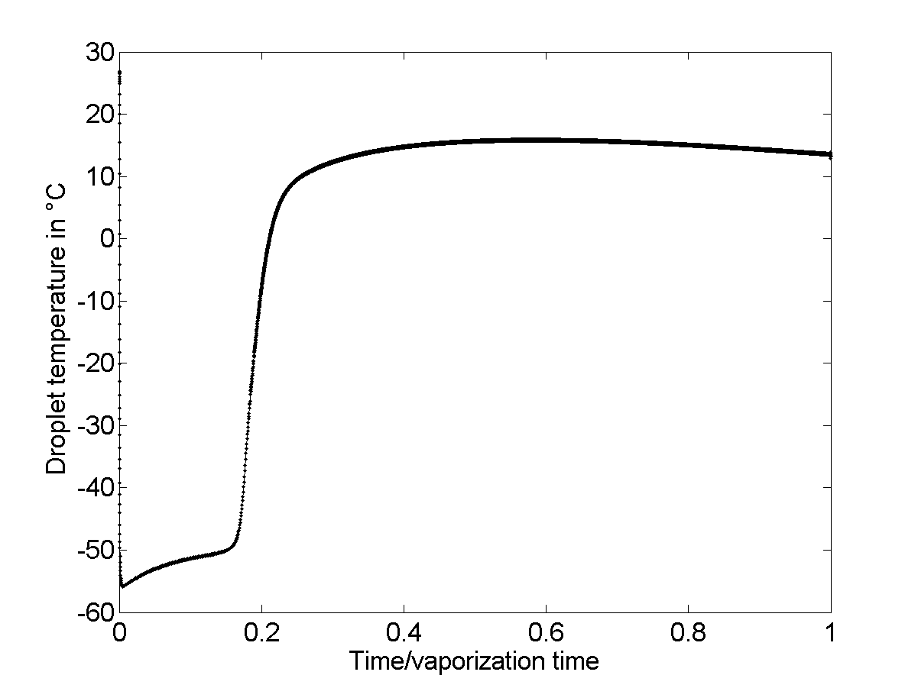
Precursor vaporization
Flash vaporisation
End of solvent vaporization
Solvent vaporization

Slide 17
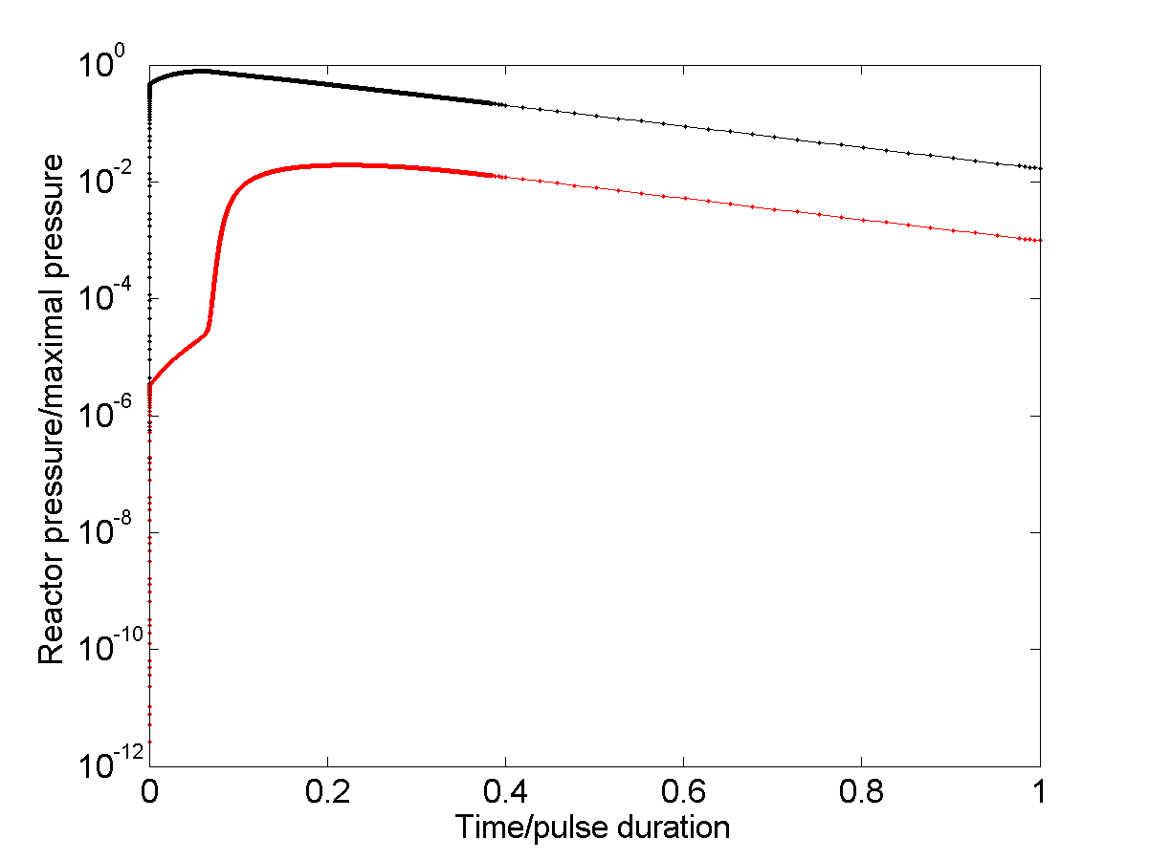
Total pressure
Precursor pressure
End of solv. vapor.
End of precursor vaporization

Slide 18
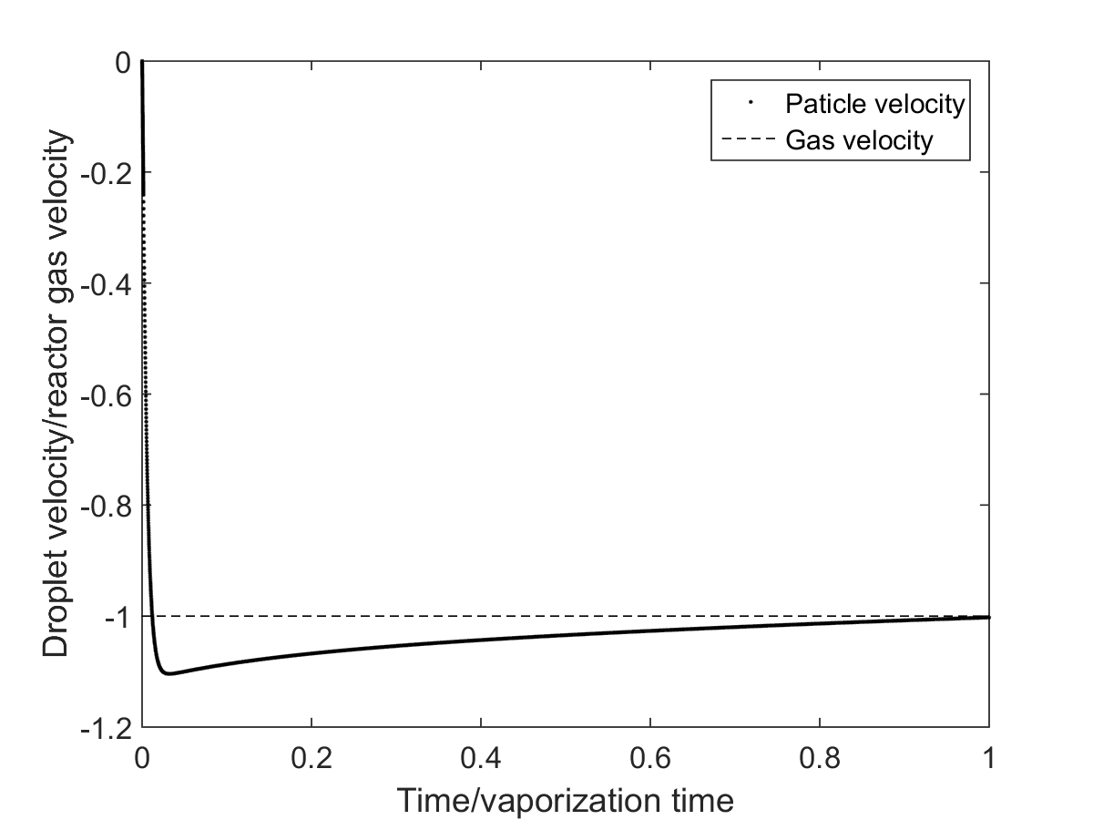
Free fall under gravity force
Braking under drag force

Slide 19
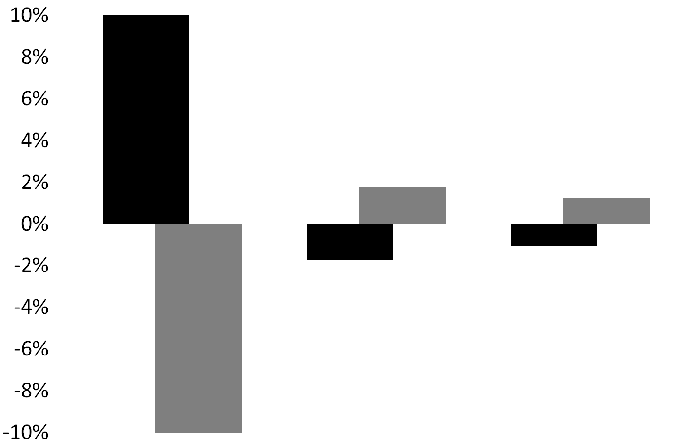
+10%
-10%
Enthalpy of vaporization
Heat capacity
of the liquid phase
Vapor pressure

Slide 20
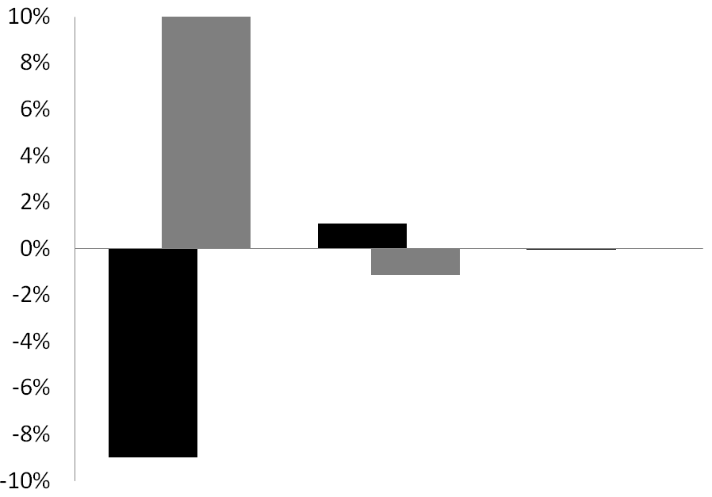
+10%
-10%
Enthalpy of vaporization
Vapor pressure
Heat capacity
of the liquid phase

Slide 21
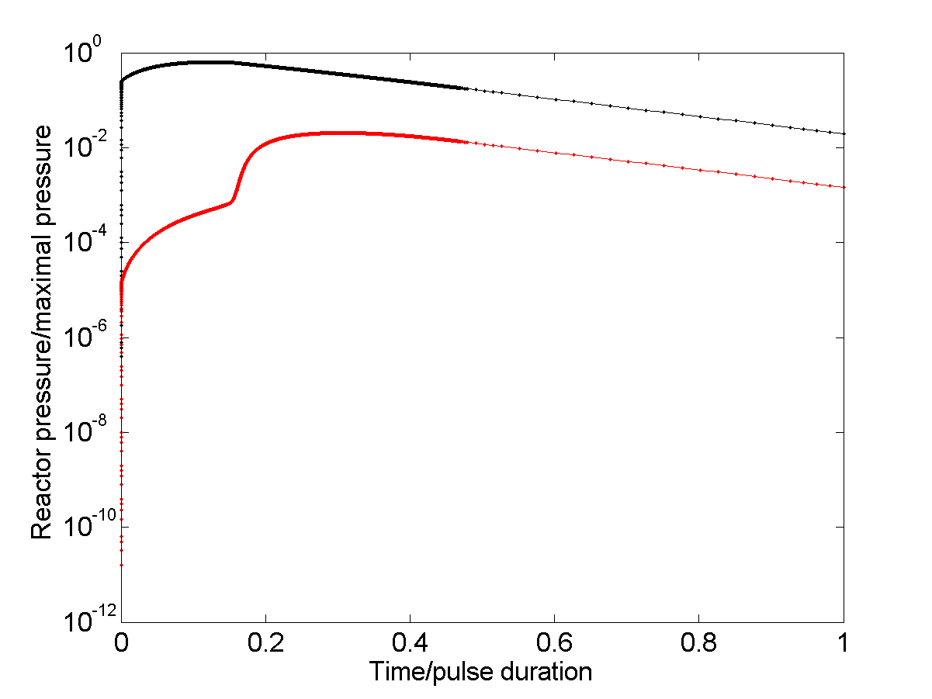
Total pressure
Precursor pressure
End of solv. vapor.
End of precursor vaporization

Slide 22
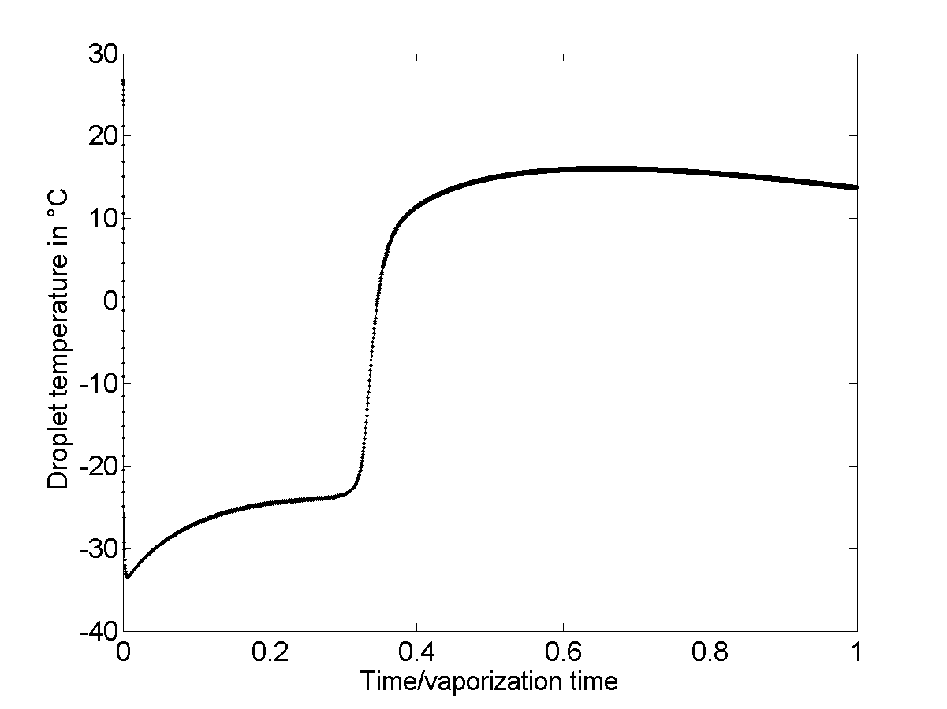
precursor vaporization
Flash vaporisation
End of solvent vaporization

Slide 23
Buffer bottle process, 0D analysis
Pure precursor

Slide 24
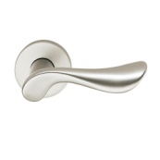
Isolation valve 2 (big)
Filling port
Buffer bottle
Deposition reactor
Isolation valve 1
Vacuum pump
Bubbler
S_{liquid}
S_{exchange}
P
Pressure transducer
Heated box

Slide 25
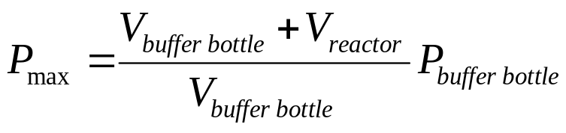
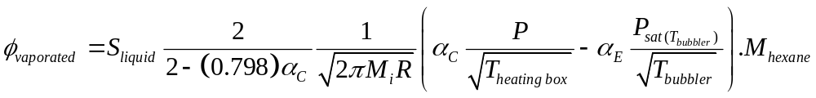
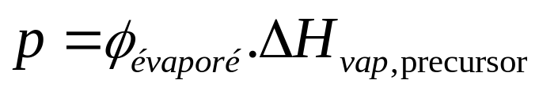
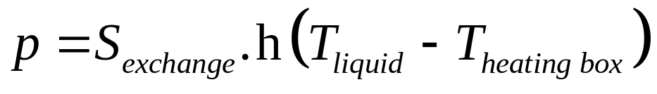
Maximal pressure you can reach :
Flux of evaporation from bubbler (liquid surface) :
kg.s⁻¹
m²
kg.mol⁻¹
Flux of evaporation from heat balance :
W
kg.s⁻¹
J.kg⁻¹
W

Slide 26
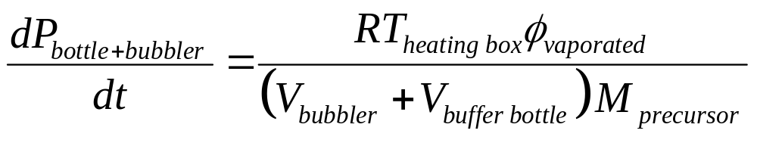
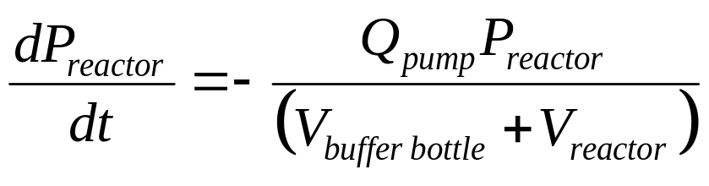
The differential equation to solve for heat balance is :
The differential equation to solve for pressure in buffer bottle :
The differential equation to solve for pressure in reactor :

